Slide 1
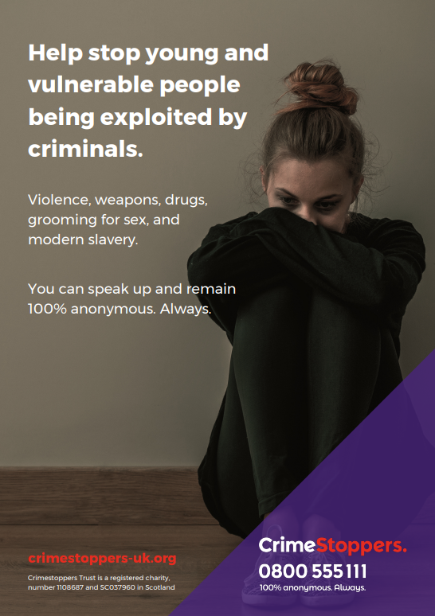
Tackling County Lines
Keeping our communities safe

Slide 2
County lines is where illegal drugs are transported from one area to another.
Serious organised criminals recruit young people or vulnerable adults to move illegal drugs both locally and across the country - often using taxis and other forms of transport.
To be able to do this, a common feature of county lines is the grooming and exploitation of young and vulnerable people.
Organised criminal gangs will often befriend others, glamorising a lifestyle whilst manipulating them in to undertake criminal activity, leading to their exploitation and abuse.
County lines is everywhere, and it affects all communities. Crimestoppers are appealing to family, friends and the whole community to speak out and to help tackle this crime.

Slide 3
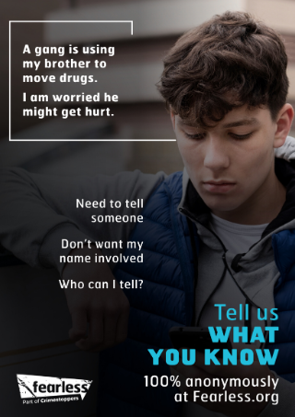
Tackling County Lines.
What is County Lines?
County Line is a term used to describe gangs and organised criminal networks involved in exporting illegal drugs into one or more area, within the UK, using dedicated mobile phone lines or other form of “deal line”. The criminal group are likely to exploit children and vulnerable adults to move and store the drugs and money and they will often use coercion, intimidation, violence (including sexual violence) and weapons.
Who is at risk?
The most at risk of grooming by organised crime groups, are children and vulnerable adults. By using an advantage of an imbalance of power to coerce, control, manipulate and deceive these people, OCG’s can befriend and groom those at risk to control them to do exactly what they want. However, these criminals are often looking for new ways in which to take control and expand their business and this means looking for new and unsuspecting people to do their bidding. This means there is no typical victim and that anyone could be at risk
What are the signs of grooming?
Frequently missing from home, school or placement
Suddenly have significant amounts of money, new phones, new clothes
Be carrying several phones and receive constant calls and messages
Unexplained injuries or start to self harm
Become withdrawn, or have unexplained out of character out bursts such as
anger, anxiety or stress
Become secretive of their whereabouts, their friends or of what they have in
their bags
TO LEARN MORE ABOUT THE SIGNS OF GROOMING CLICK HERE

Slide 4
Transportation and Taxis.
The movement of young and vulnerable people.
Taxis are a popular choice for the transportation of young and vulnerable people who have been groomed into the County Lines process and they will be travelling for the purposes of exploitation and / or abuse. They may be carrying drugs and / or money and travelling to new unfamiliar locations to sell drugs and to potentially set up in a new cuckooed property.
As much as it is very difficult to identify every one of these people in a short car ride, there are signs that you could look for or notice that do not add up or give you that feeling that something is not right, and that this young or vulnerable person could be in trouble.
Signs to spot of someone being transported for exploitation:
Travelling alone? Unfamiliar with the local area?
Travelling at unusual hours (during school time, early in the morning, or late at night?
Paying for journeys in cash or prepaid? Carrying lots of cash?
Was the journey booked for them? On their behalf?
Did they get dropped off before getting into the Taxi?
Anxious, frightened, angry, showing signs of neglect or displaying other behaviour that makes you worried?
Using words describing criminal or sexual activity?
TO LEARN MORE ABOUT THE SIGNS THAT SOMEONE IS BEING TRANSPORTED FOR EXPLOITATION, CLICK HERE

Slide 5
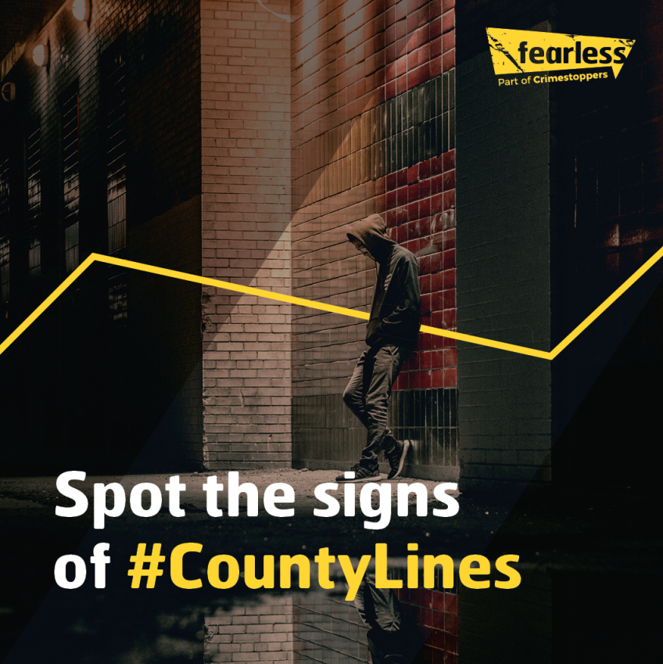
How you can support us.
Click below to download the following assets to share across your social media accounts, your networks and to display in your taxis:
Leaflets and posters
Social Media Carousels
Taxis stickers and artwork
Transportation and County Lines assets:
Google Drive Link
Transportation and County Lines assets:
SharePoint Link
To learn more about our campaign, please contact: Lydia.Patsalides@crimestoppers-uk.org

Slide 6
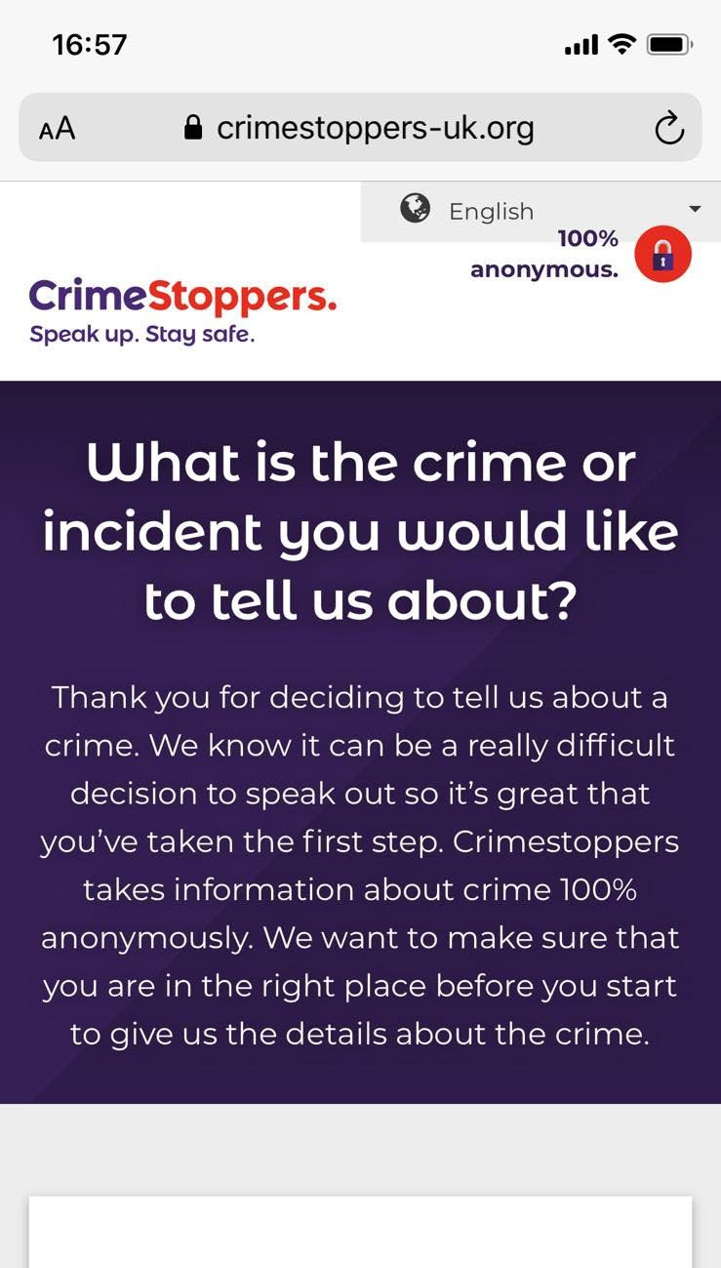
We believe everyone has the right to feel safe from crime, wherever they live, wherever they work, for ourselves and all those we care about.
But sometimes people might be worried about a crime, or something that’s wrong, and want to pass on information. Which is why it’s good to know they can always trust Crimestoppers.
We’re an independent charity that gives people the power to speak up and stop crime, 100% anonymously. By phone and online, 24/7, 365 days a year.
No police contact. No witness statements. No courts. Every year we help stop thousands of crimes.
Support us to help make communities safer together.

Slide 7
Fearless is the dedicated youth service from the charity, Crimestoppers, where young people can access non-judgemental information and advice about crime and criminality.
Fearless aims to break down any barriers that might prevent young people from reporting crime. Whether this is a fear of the process, fear of repercussions or a distrust of the police, Fearless aims to empower young people to speak out.
Young people can pass information about crime 100% anonymously via an online form at Fearless.org or by calling our 0800 555 111 phone lines, 24/7, 365 days a year.
When giving information via Fearless, no personal details are taken and Fearless cannot trace the phone number or IP address of the people making contact with them.

Slide 8
Breaking the wall of silence since 1988.

